Slide 1
Elkhorn Slough King Tide
Citizen Science Monitoring
Goal: to obtain repeat photographs of the same sites over time, so we can track variation in water levels over time (due to tidal, seasonal, and weather variation, and over the long-term, due to global sea level rise)
Approach: citizen scientists take photographs from the same vantage points during predicted King Tide events (highest tides of the year, around winter solstice full moon) as well as at other times of year to capture variation.
Please email your photos to Virginia (virginia@elkhornslough.org) to organize in folders with other photos from the site, and to submit to the CA King Tide website.
You can also directly upload your photos to the CA King Tide website. All photos should be tagged with “site location” (exactly as marked with *on next pages), “CA King Tide”, “year”, and “high” or “low” to describe tide. You have to use quotes for multi-word tags. See detailed instructions at : http://www.californiakingtides.org/share-pictures/
Locations: citizen scientists are encouraged to visit exactly the locations described on the next pages

Slide 2
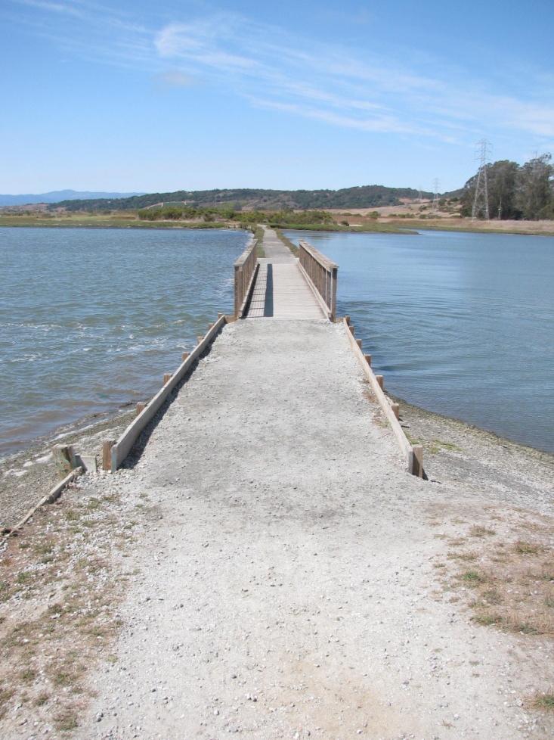
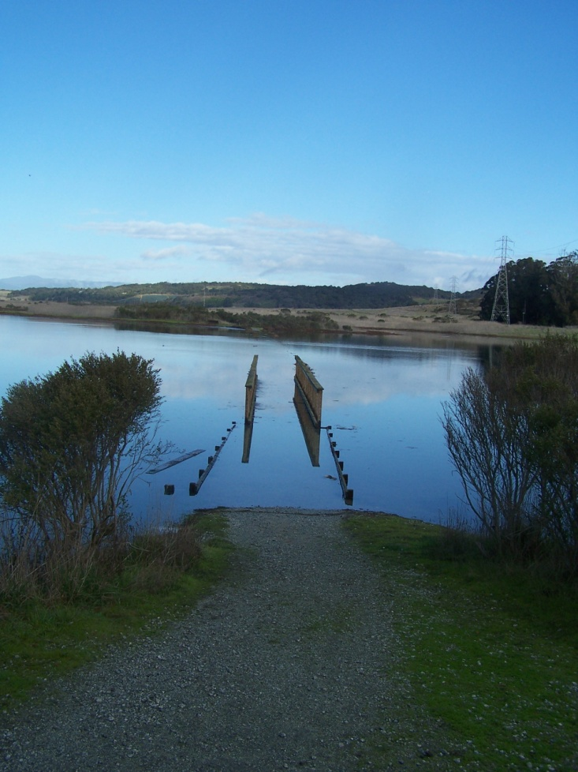
South Marsh, Elkhorn Slough Reserve
Coordinates: 36º49’10.85 N , 121º44’13.48 W
Parking: lot near Visitor Center at Elkhorn Slough Reserve
Public access times: 9 AM – 5 PM, Wednesday-Sunday only (access during other times can be arranged for this project by special permission)
*South Marsh Footbridge*
Stand about 50 ft S of bridge and shoot photo to N

Slide 3
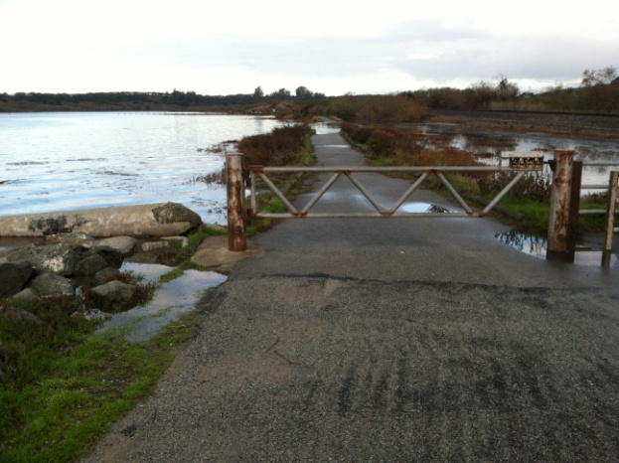
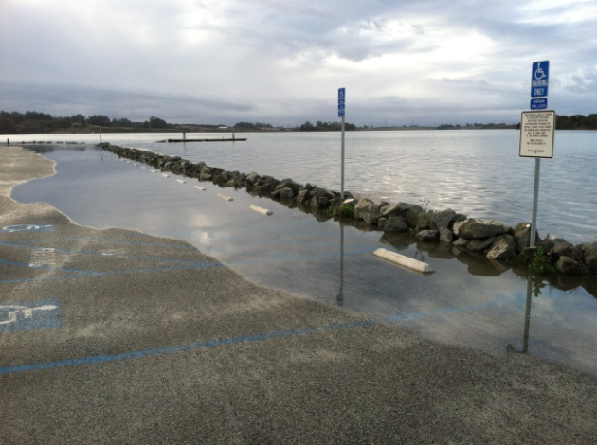
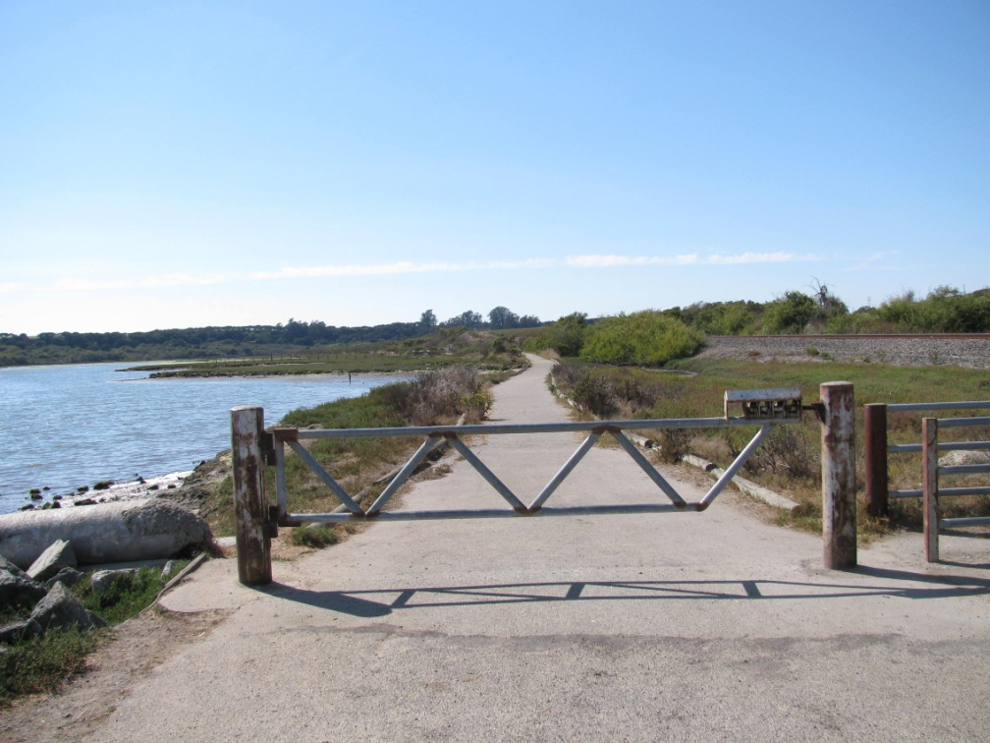
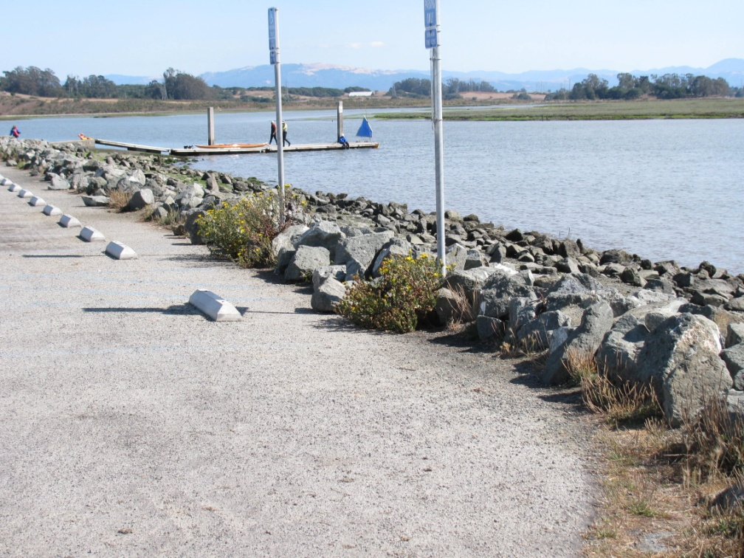
Kirby Park
Coordinates: 36º50’25.58 N , 121º44’38.48 W
Parking: parking lot at Kirby Park
Public access times: daylight hours
*Kirby Parking Lot*
Stand in similar location as for previous photo, but face S and shoot towards dock in distance
*Kirby Nature Trail*
Stand about 30 ft S of gate to nature trail and shoot photo to N, through gate

Slide 4
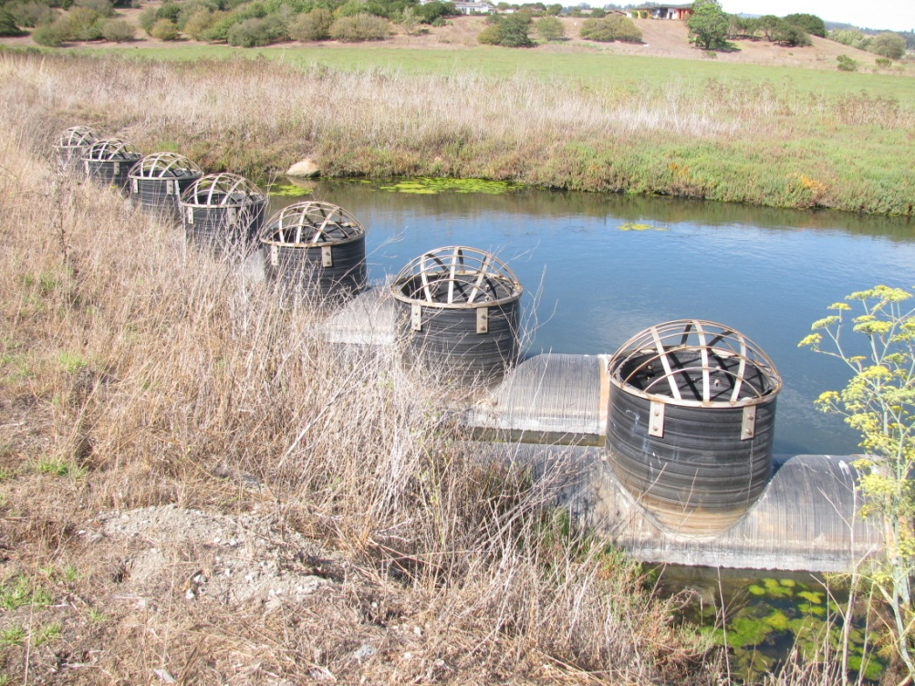
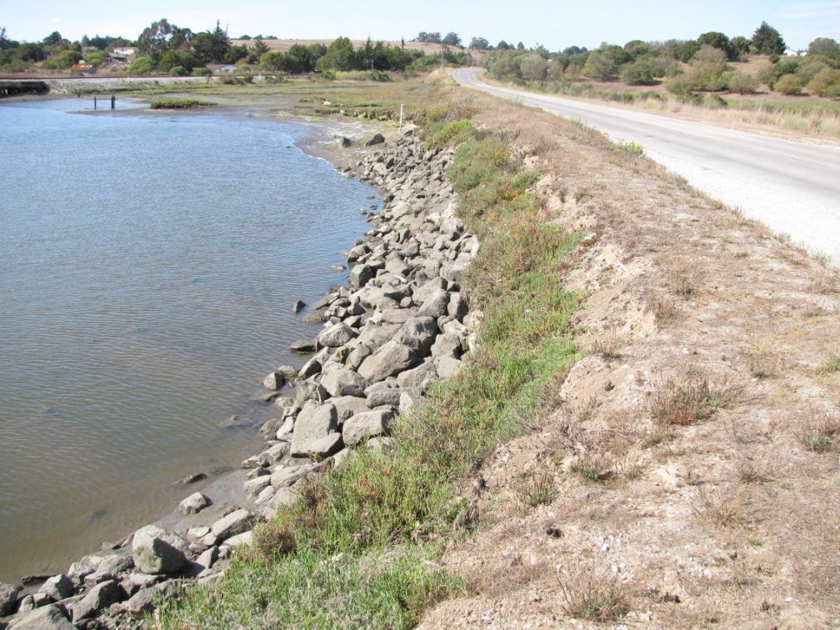
Porter Marsh and Hudson Landing
Coordinates: 36º51’22.70 N , 121º45’17.97 W
Parking: on pulloff along Elkhorn Road at Hudson landing (where you see extensive marsh to E, wooden trestle RR bridge to W). Be careful to pull completely off road, and take caution when crossing the road.
Public access times: 24 hrs
*Porter Marsh*
stand on E side of road, just S of the culverts under the road, and shoot photo towards NE
*Hudson Landing*
stand on W side of road, just S of the culverts under road, and shoot towards NW

Slide 5
Moss Landing Harbor
Coordinates: ?
Parking: ?
Public access times: ?
We should set up a long-term monitoring site somewhere near permanent, non-floating infrastructure somewhere in the Moss Landing area.
Site location TBD, suggestions are welcomed.

Slide 6
BACKGROUND ON KING TIDES
King tides are the highest tides of the year
Tides are the lifeblood of the estuary, and their daily rise and fall is natural.
Extreme tides are also natural: during the full and new moon weeks near the winter and summer solstice, we always have especially high and low tides
Low pressure systems associated with storms can also make high tides even higher than predicted
King tides are not in themselves a sign of climate change, just part of the natural rhythms of an estuary
King tides help us to envision future sea level rise
There is strong data showing that average water levels have been increasing on the California coast, and the height of these extreme high tides has been increasing even more than the average water level
Robust models make clear that sea level rise will accelerate over the coming decades, although no one knows exactly how much
King tides are about 4 feet above average water levels, and are a good way of picturing what that future sea level rise will look like
Instead of a tide like this happening exceptionally, once or twice a year, high tides will reach this level every day, in a few decades, given current projections
This will have big implications for human infrastructure: on king tides we have flooding of roads, bridges, railroad trestles around the estuary
Sea level rise will also have big effects on the animals and plants that depend on the estuary

Slide 7
CONSERVATION AND SEA LEVEL RISE
Rising sea levels will affect estuarine biodiversity and habitats
Water levels affect distribution of animals and plants in estuaries: species are specialized for particular zones, that receive different levels of daily flooding vs. drying
Salt marshes are particularly vulnerable to changes in water levels, because they can only survive in a very narrow elevational zone, where they don't get too much or too little tidal flooding
Elkhorn Slough has some of the most extensive salt marshes left in California, after SF Bay, but existing marshes are in danger of being drowned as average sea levels rise
Restoration and conservation can support resilience of estuarine ecosystems in the face of sea level rise
Raising the elevation of salt marshes may help give them the needed “elevation capital” to track sea level rise: ESNERR is currently initiating a sediment addition project to restore and sustain salt marsh in one part of the Reserve
Another approach is to facilitate the migration the upward migration of marshes as sea levels rise: such a strategy may be possible in parts of the estuary, because ESF, ESNERR, and other partners have succeeded in conserving many lands adjacent to today's salt marshes
Conserving wetlands and the species that depend on them requires this sort of a watershed view: boundaries are changing due to climate change, so our best bet is conservation and restoration at a watershed scale, so we can take care of the estuary as a legacy for future generations

