Slide 1



CDFW Climate College: Building Staff Capacity to Address Climate Change
Whitney Albright
California Department of Fish and Wildlife
C-CATC Meeting
August 14, 2013

Slide 2
DFW Climate College
Outline
Goals
Planning the course
Course structure and features
Course summary
Lessons learned

Slide 3
Goals
Provide a foundation of climate change knowledge for ALL staff
Empower staff to incorporate climate change into their work
Build a climate community at across branches/regions at DFW that includes our partners

Slide 4

Planning the Course: A Florida Model
Doug Parsons and Laura Jerome
Florida Fish and Wildlife Conservation Commission
Notes:
4

Slide 5
Planning the Course: Climate Training Work Group
CDFW Climate Change Stakeholders

Slide 6
Course Structure & Features: Components
Monthly lectures (10 months)
Recommended readings
Participation in on-line forum
Final project
Opportunities for Certification
Awards ceremony
Notes:
6

Slide 7
Course Structure & Features: Schedule
Welcome and Introduction
Climate 101; understanding the basics of climate science and what we can do about it
What's happening? Projected climate change impacts to California
The National Response: What are other state and federal partners doing?
Go Big or Go Home: Collaborative Partnerships in a Changing Climate
Climate Literacy and Education
Energy-Climate-Human Nexus: Climate Action co-benefits for Natural Resource Conservation
In it for the long haul: CDFW Going Green Sustainability Initiative
Walk the Talk: CDFW Testimonials

Slide 8
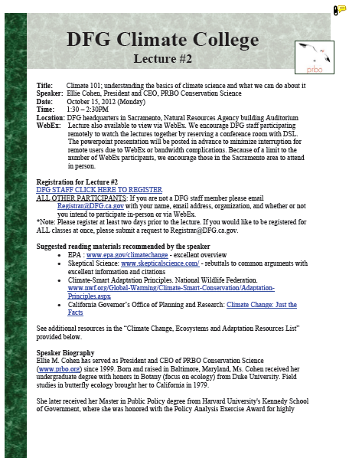
Course Structure & Features: Resources

Slide 9
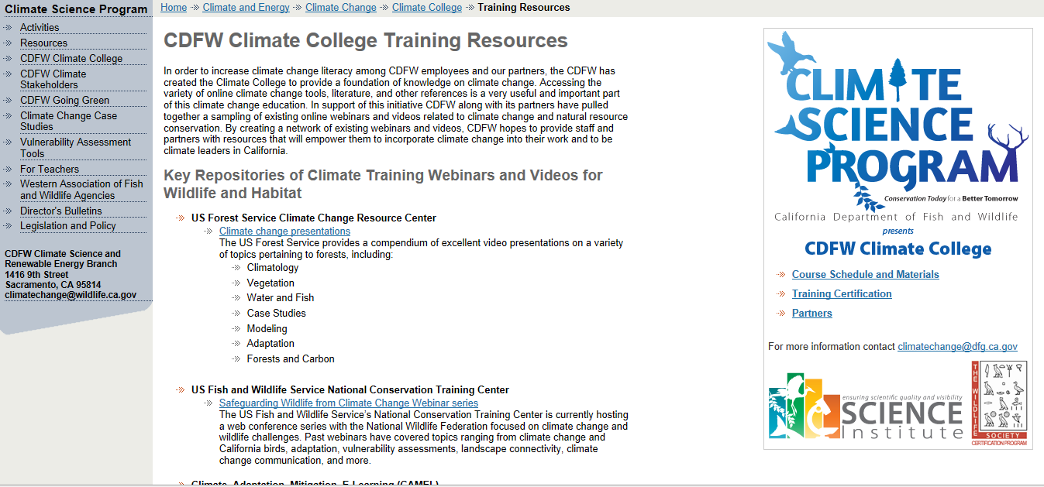
Course Structure & Features: Resources

Slide 10
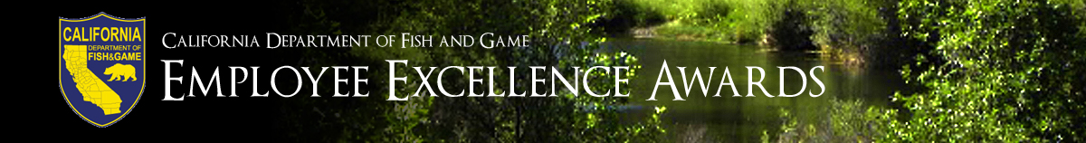

Course Structure & Features: Incentives
DFW Certification
DFW Employee Excellence Awards
TWS Certification

Slide 11
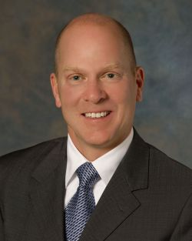
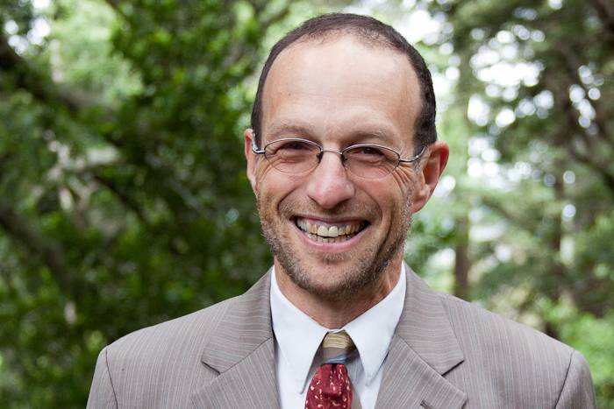
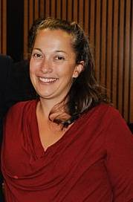
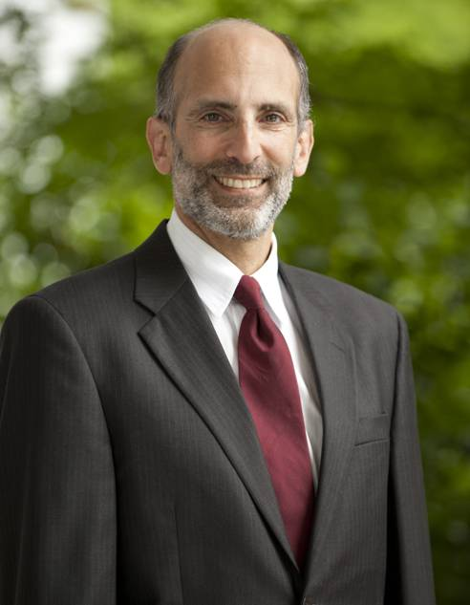
The Course Begins!
Lecture #1-- September 2012
176 registered
  111 DFW (63%)
  65 partners (37%)
+75% registered for full 10 month course
DFW: All regions equally represented
DFW: 15 Branches/Programs - All Divisions represented
Cliff Rechtschaffen, Governor’s Office
Chuck Bonham, DFW
Ken Alex, Governor’s Office
Amber Pairis, DFW

Slide 12
The Course Begins!
Partner Participation
Miscellaneous Category: Representatives from CA Universities, professional scientific society, Tribal representation, local government, industry (utilities), journalist
N=65

Slide 13

Course Summary: CDFW Climate College by the Numbers
348 total participants
23 projects submitted
  19 CDFW staff
  8 partners
9 lectures/guest speakers
1 happy Climate College Team

Slide 14
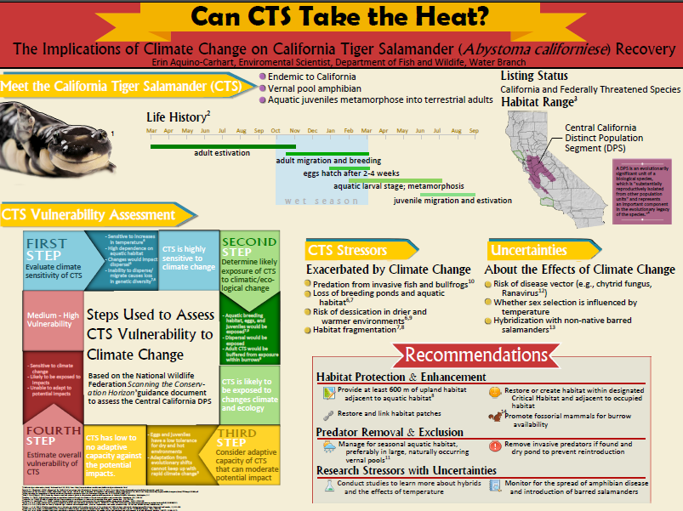
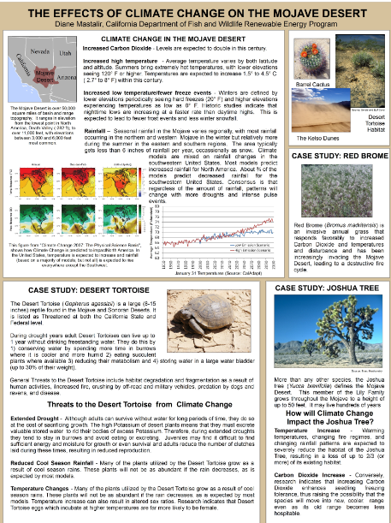
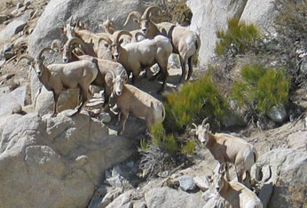
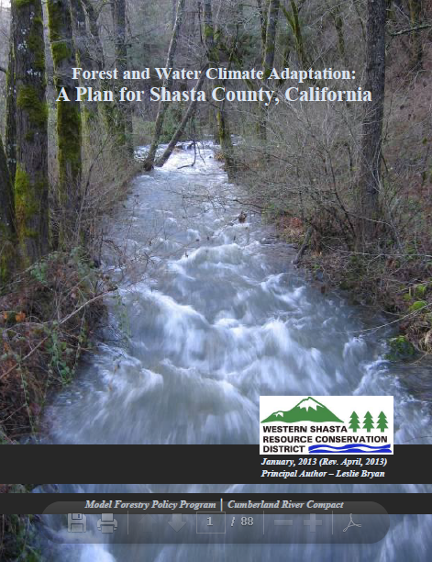
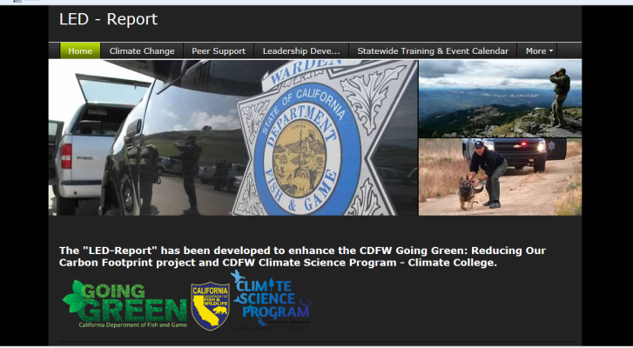
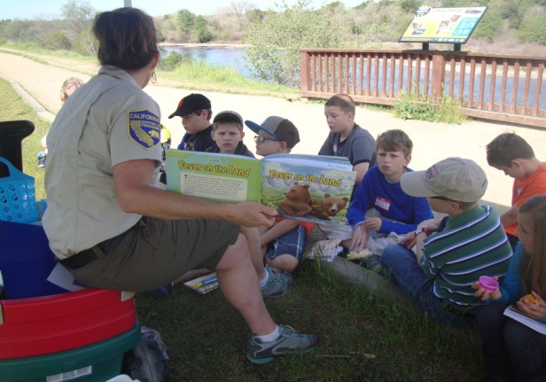
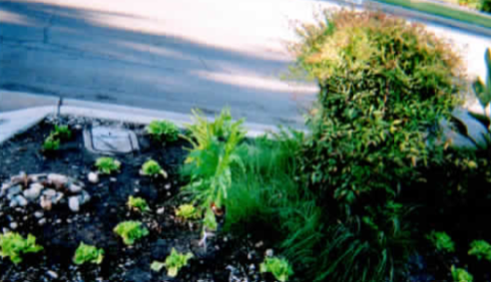
Awards Ceremony

Slide 15
Course Evaluations
More science!
Dynamic speakers favored
Desire for additional discussion
Not all info useful in relation to staff work

Slide 16
Lessons Learned
Remote participation is a challenge
Technology will always get the better of you
A discussion forum requires TLC
A ten-month attention span is only somewhat reasonable
Thinking about how you measure the of success of a project is best done BEFORE the project takes place

Slide 17
Successes
College projects
Speaker line-up
Flexibility of course participation
Internal communication

Slide 18
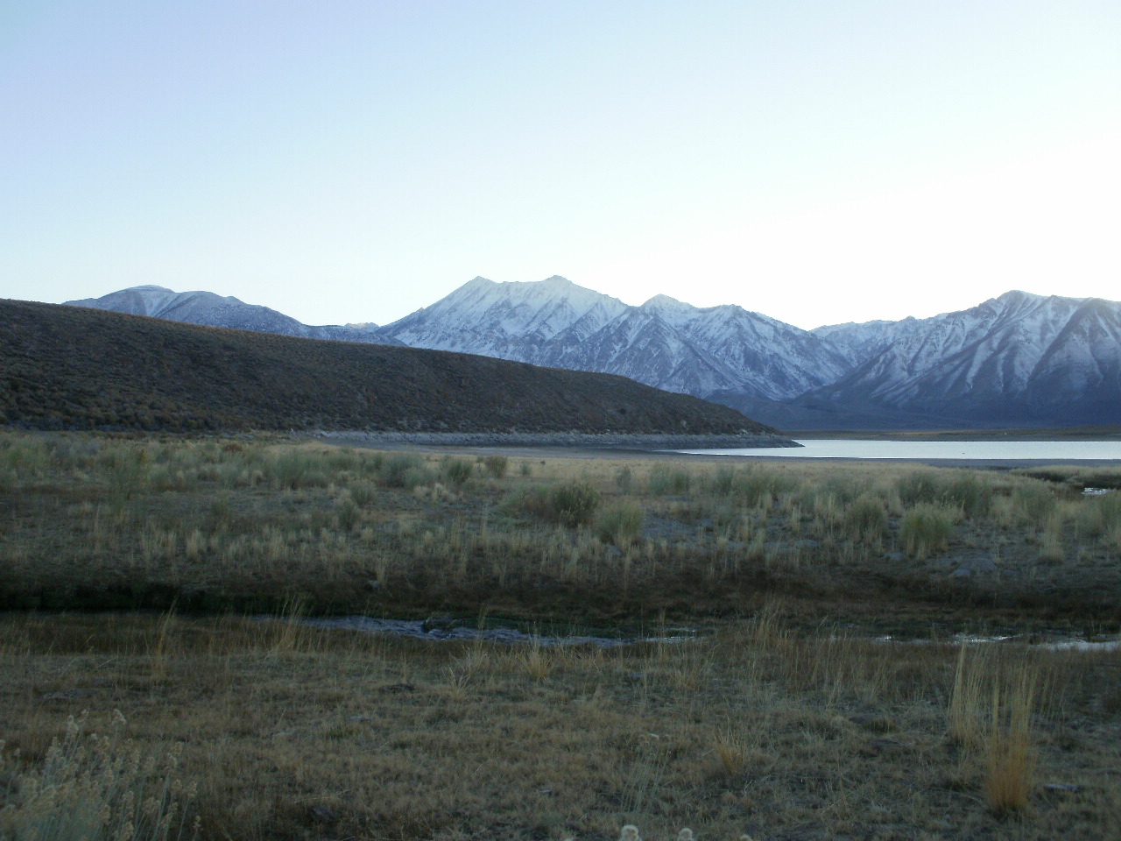
Next Steps
Future iterations of the Climate College:
    Marine focus
    Traditional Ecological Knowledge

Slide 19
Thank you!
DFW Climate College www.dfg.ca.gov/Climate_and_Energy/Climate_Change/Climate_College/
DFW Climate Change website www.dfg.ca.gov/Climate_and_Energy/Climate_Change/
Email: whitney.albright@wildlife.ca.gov

