Slide 1
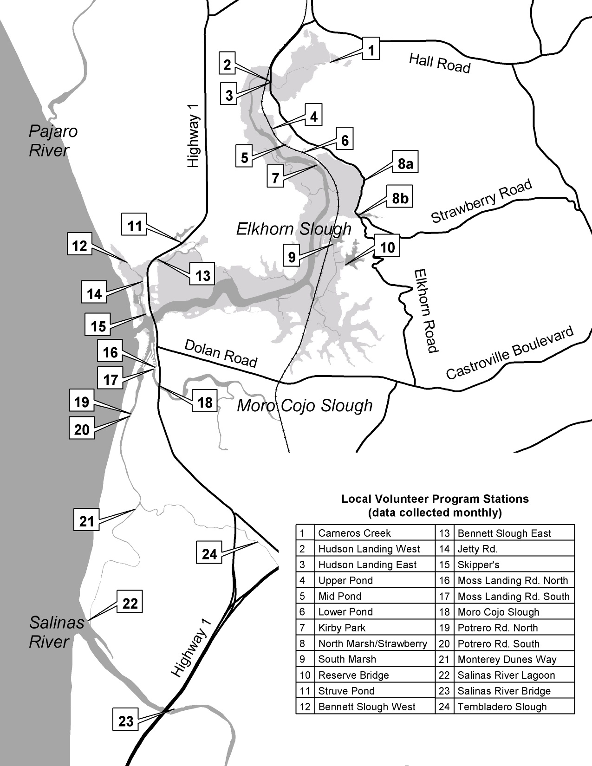

Slide 2
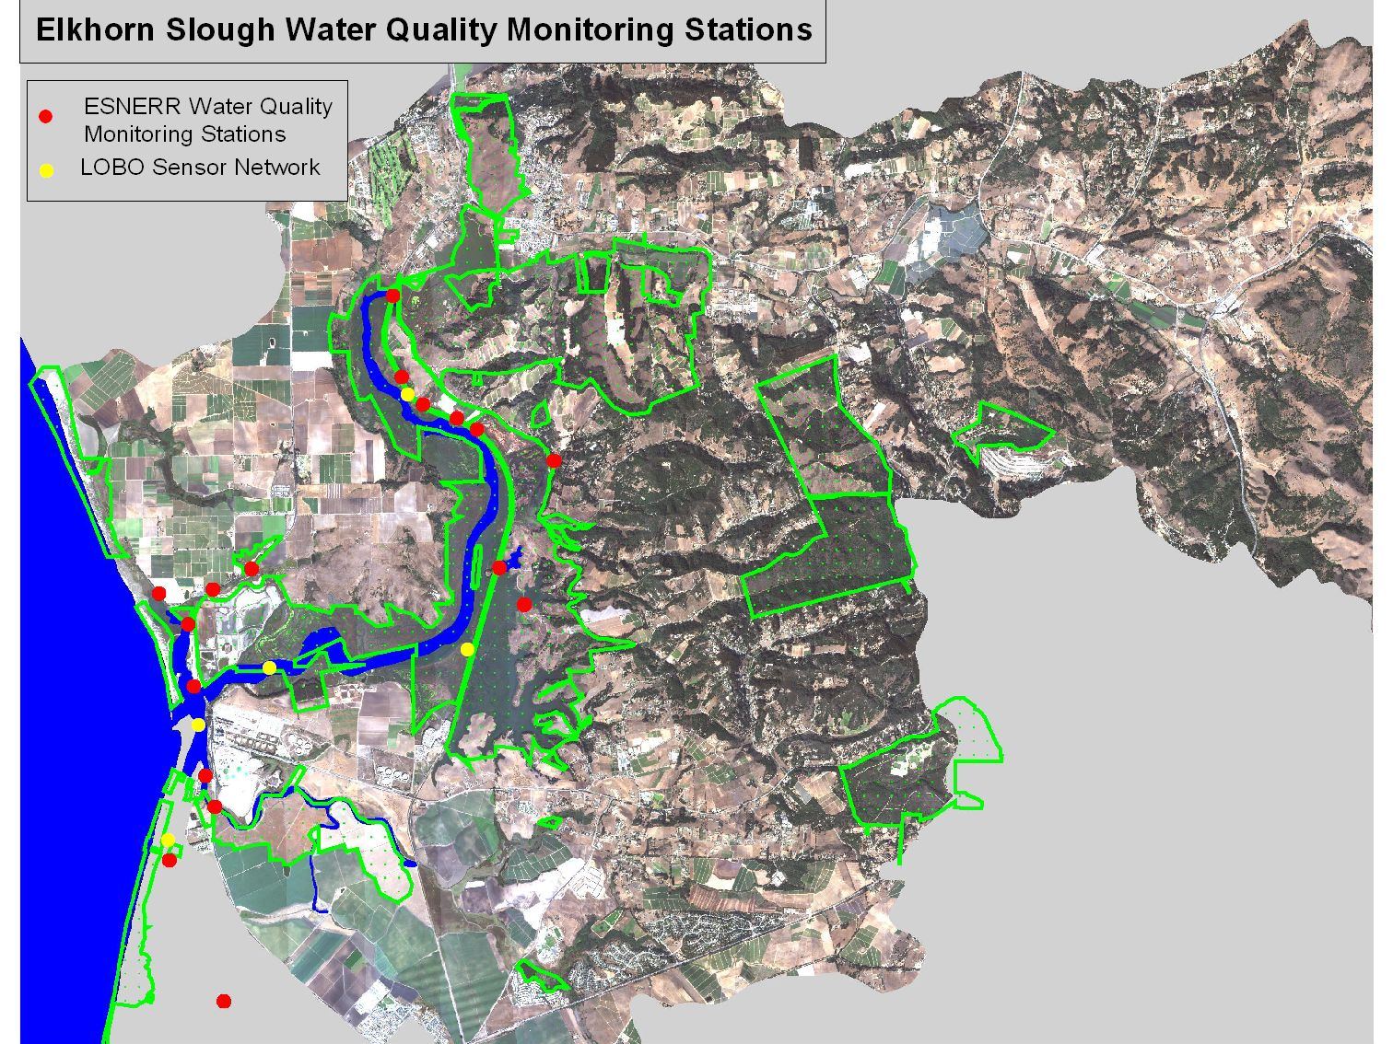
Volunteer
NERR WQ stations

Slide 3
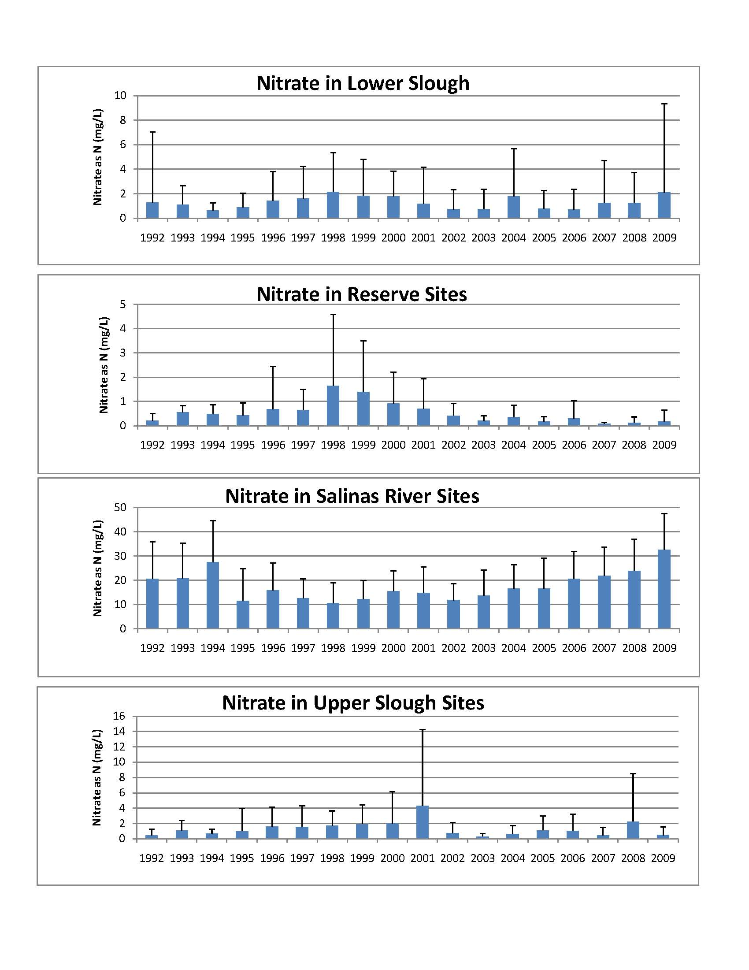
Nutrient pollution varies by region
Monthly volunteer program at 24 estuarine stations shows that nitrate concentrations vary by region of the slough. Salinas river sites appear to be increasing while reserve sites appear to be decreasing in the last decade. [see http://www.elkhornslough.org/research/waterqualityvolunteer.htm]

Slide 4
Chl Varies by Region too .

Slide 5
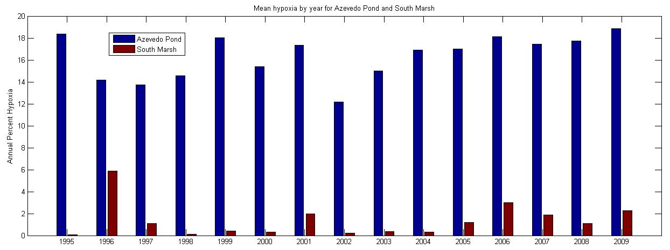
Oxygen has remained steady
Overall, dissolved oxygen in Slough waters monitored by a continuously deployed water quality sensor at two sites has not changed over the past decade, with low oxygen conditions threatening to wildlife remaining relatively rare.
[see http://www.elkhornslough.org/research/waterquality nerrs.htm for more information]

Slide 6
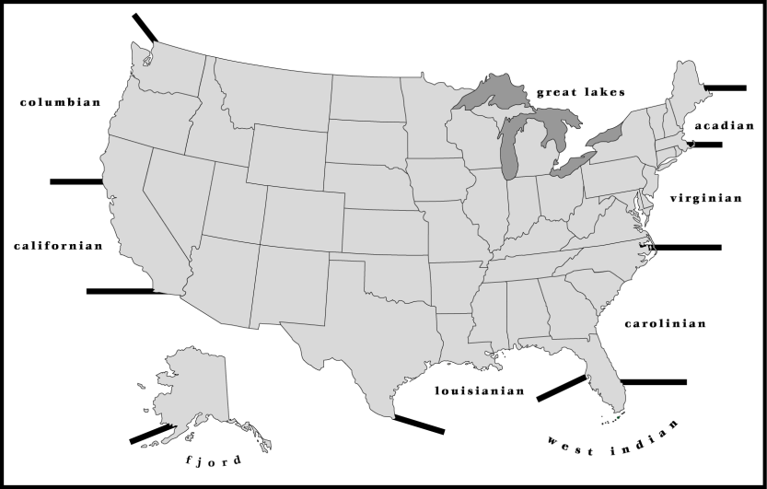
How different are the NERR sites?
Comparison of means of all available data by Reserve and Station, 2002 – 2006/7
OWC
WEL
DEL
PDB
HUD
CBM
WKB
APA
SFB
TJR
SOS
CBV
JAC
GRB
ELK
KAC
NOC
WQB
NIW
ACE
http://nerrs.noaa.gov
NAR
GND
SAP
GTM
RKB
JOB
0.001
0.01
0.1
1
10
mg NO_{x} L⁻¹

Slide 7
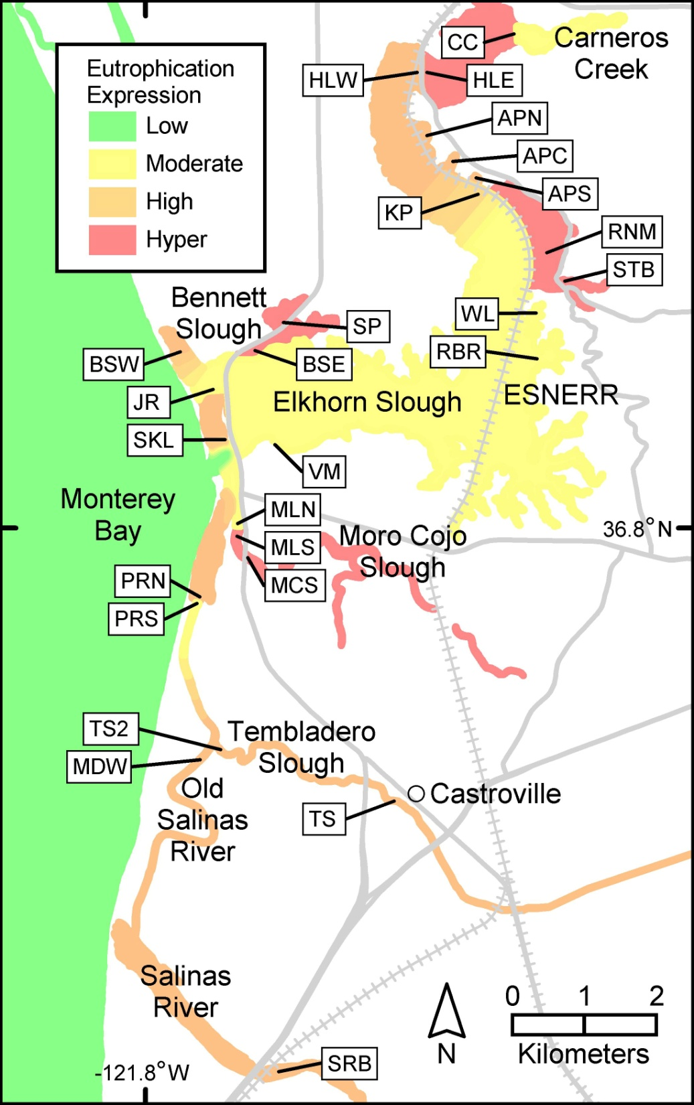

Slide 8
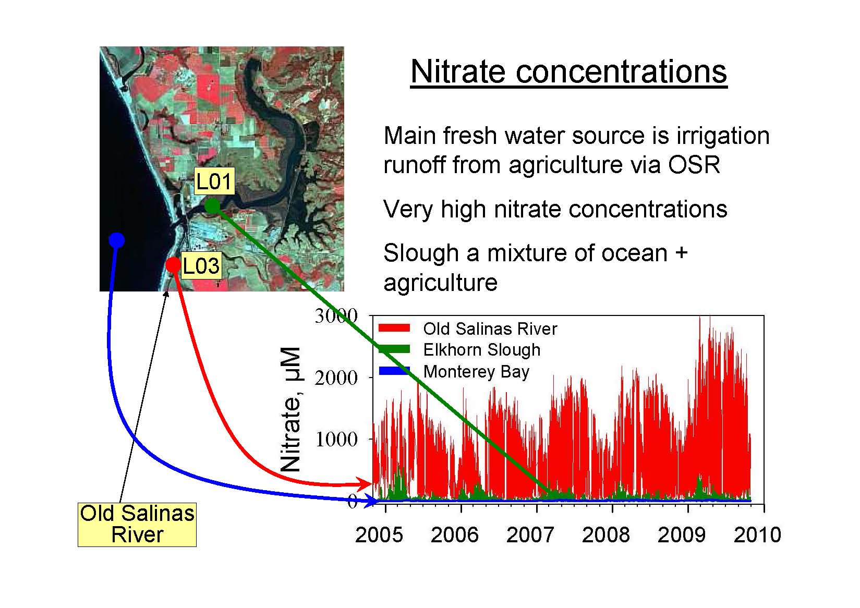
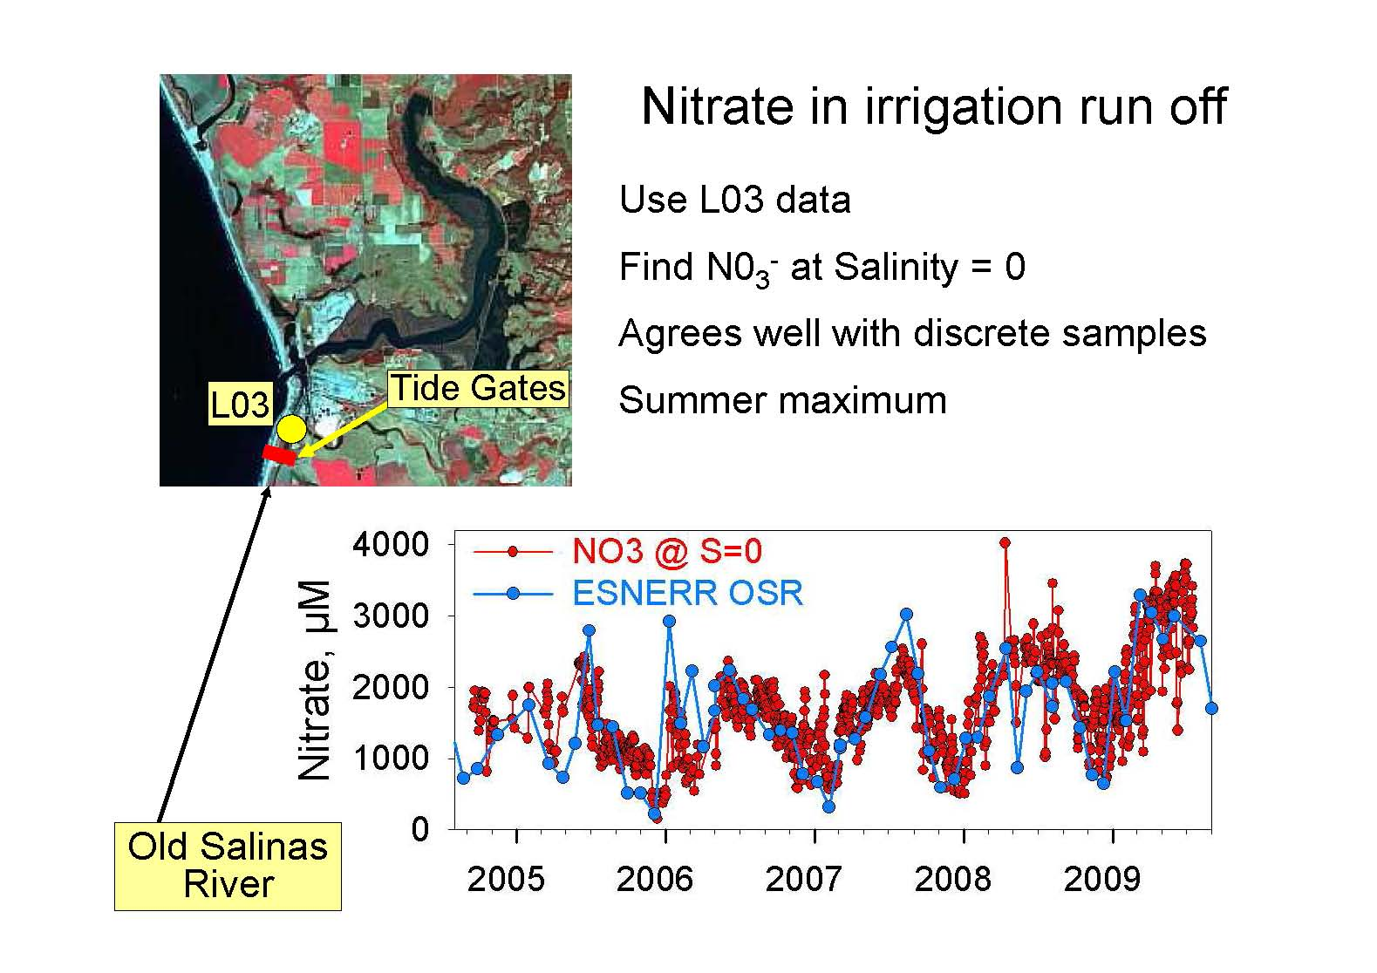

Slide 9
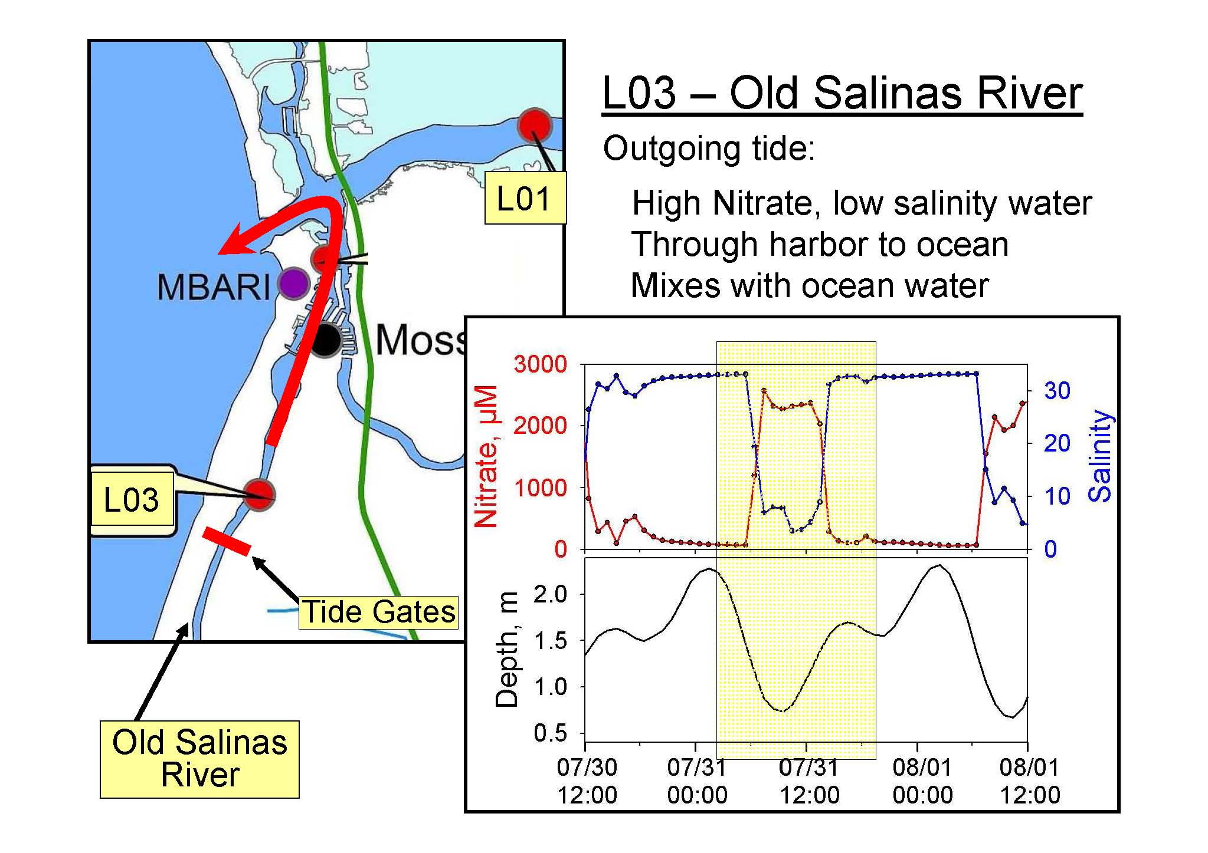

Slide 10
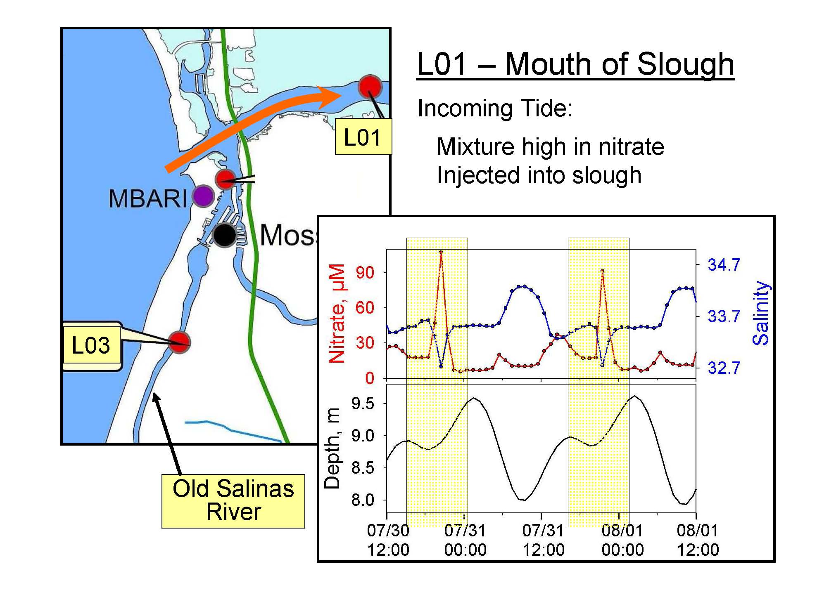

Slide 14
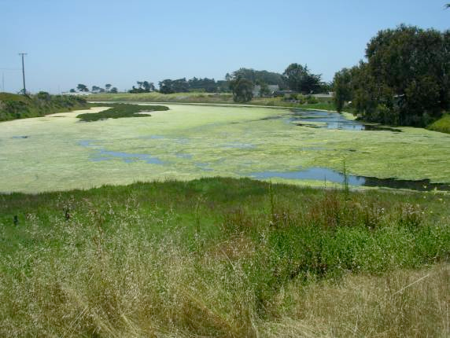

Slide 15
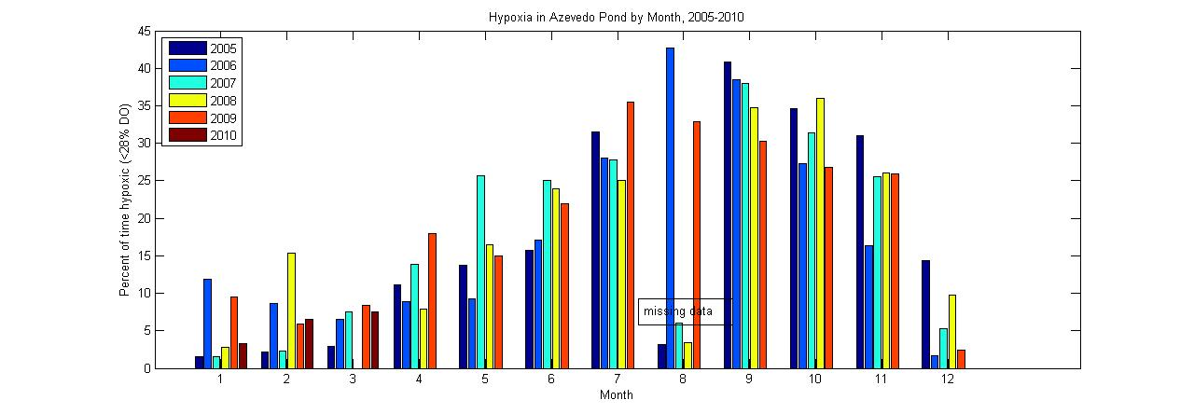
Percent of time DO below 28% (hypoxic) by month of the year in Azevedo Pond

Slide 16
Tidal range vs % time hypoxic
Figure 5. Maximum tidal exchange v. % time hypoxic

Slide 17
How different are the NERR sites?
Comparison of means of all available data by Reserve and Station, 2002 – 2006/7
WEL
WKB
CBM
OWC
DEL
WQB
ACE
MAR
CBV
TJR
ELK
APA
SAP
NIW
SFB
GND
GRB
PDB
NOC
http://nerrs.noaa.gov
HUD
RKB
GTM
JAC
SOS
JOB
KAC
NAR
0.1
1.0
10
100
μg Chl a L⁻¹

